Slide 1

A+ Guide to Hardware, 9th Edition
Chapter 6
Supporting Hard Drives and Other Storage Devices
Notes:
A+ Guide to Hardware, 9th Edition
Chapter 6
Supporting Hard Drives and Other Storage Devices

Slide 2
Objectives
Discuss technologies used inside a hard drive and how a computer communicates with a hard drive
Install and support a hard drive
Identify tape drives and tape cartridges
Support optical drives and flash memory devices
Troubleshoot hard drives
Notes:
Objectives
Discuss technologies used inside a hard drive and how a computer communicates with a hard drive
Install and support a hard drive
Identify tape drives and tape cartridges
Support optical drives and flash memory devices
Troubleshoot hard drives

Slide 3
Hard Drive: (Technologies and Interface Standards)
Hard drive or hard disk drive (HDD): Most important permanent storage.
Hard disk drive (HDD) sizes
3.5" size for desktops
2.5" size for laptop computers
1.8" size for low-end laptops, other equipment
Notes:
Hard Drive Technologies and Interface Standards
Hard disk drive (HDD) or hard drive sizes
2.5" size for laptop computers
3.5" size for desktops
1.8" size for low-end laptops, other equipment

Slide 4
Technologies Used Inside a Hard Drive
Three types:
Magnetic hard drive
One, two, or more platters, or disks
Stacked together, spinning in unison inside a sealed metal housing
Firmware controls data reading, writing and motherboard communication
The top and bottom of each disk have a Read/write head that moves across the disk surface
Data is organized in concentric circles, called tracks
Tracks are divided into segments called sectors
Most current drives use 4096-byte sectors
Notes:
Technologies Used Inside a Hard Drive
Magnetic hard drive
One, two, or more platters, or disks
Stacked together, spinning in unison inside a sealed metal housing
Firmware controls data reading, writing and motherboard communication
Read/write heads are controlled by an actuator
Data is organized in concentric circles, called tracks
Tracks are divided into segments called sectors
Most current drives use 4096-byte sectors
Hybrid hard drives use both technologies
Operating system must support it

Slide 5
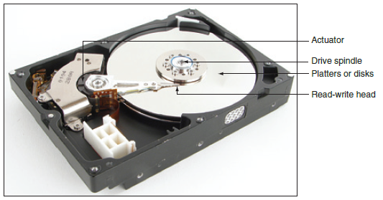
Technologies Used Inside a Hard Drive
Figure 6-3 Inside a magnetic hard drive
Notes:
Technologies Used Inside a Hard Drive

Slide 6
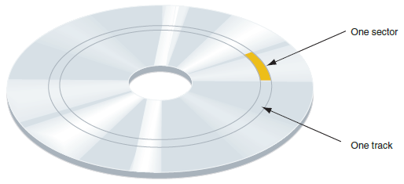
Technologies Used Inside a Hard Drive
Figure 6-4 A hard drive is divided into tracks and
sectors; several sectors make one cluster
Notes:
Technologies Used Inside a Hard Drive

Slide 7
Technologies Used Inside a Hard Drive
Solid state drive (SSD) or solid state device (SSD)
No moving parts
Built using nonvolatile flash memory stored on EEPROM (Electronically Erasable Programmable Read Only Memory) chips
Memory in an SSD is called NAND flash memory
Lifespan is based on the number of write operations to the drive
Expensive technology, but faster, more reliable, last longer, and use less power than magnetic drives
Hybrid hard drives use both technologies
Operating system must support it
Notes:
Technologies Used Inside a Hard Drive
Solid state drive (SSD) or solid state device (SSD)
No moving parts
Built using nonvolatile flash memory stored on EEPROM (Electronically Erasable Programmable Read Only Memory) chips
Memory in an SSD is called NAND flash memory
Lifespan is based on the number of write operations to the drive
Expensive technology, but faster, more reliable, last longer, and use less power than magnetic drives

Slide 8
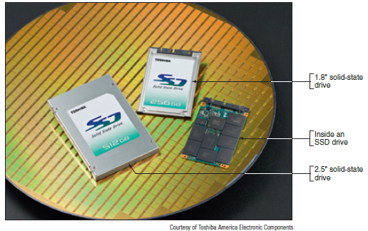
Technologies Used Inside a Hard Drive
Figure 6-2 Solid-state drives by Toshiba
Notes:
Technologies Used Inside a Hard Drive

Slide 9
Technologies Used Inside a Hard Drive
Low-level formatting – sector markings are written to the hard drive at the factory
Not the same as high-level formatting performed for Operating System installation
Firmware, UEFI/BIOS and OS use logical block addressing (LBA) to address all hard drive sectors
Size of each sector + total number of sectors determine drive capacity
S.M.A.R.T – Self-Monitoring Analysis and Reporting Technology(Can be enabled or disabled from the BIOS). Used to predict when a drive is likely to fail
Notes:
Technologies Used Inside a Hard Drive
Low-level formatting – sector markings are written to the hard drive at the factory
Not the same as high-level formatting performed for Operating System installation
Firmware, UEFI/BIOS and OS use logical block addressing (LBA) to address all hard drive sectors
Size of each sector + total number of sectors determine drive capacity
S.M.A.R.T – Self-Monitoring Analysis ad Reporting Technology
Used to predict when a drive is likely to fail

Slide 10
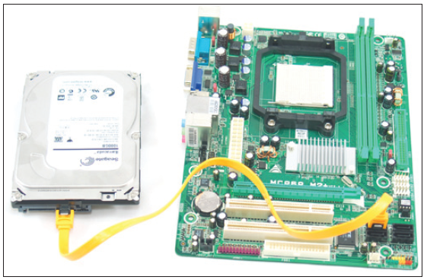
Interface Standards Used By a Hard Drive
All current hard drives use the Serial ATA (SATA) interface standards to connect to the motherboard
External hard drive methods
External SATA (eSATA), FireWire, or USB
Figure 6-5 A SATA cable connects a single SATA drive to a motherboard SATA connector
Notes:
SATA Interface Standards Used By a Hard Drive
All current hard drives use the Serial ATA (SATA) interface standards to connect to the motherboard
External hard drive methods
External SATA (eSATA), FireWire, or USB

Slide 11
Interface Standards Used by a Hard Drive
Interface standards define data speeds and transfer methods with a computer system
Also define types of cables and connectors
Standards
Developed by Serial ATA International Organization (SATA-IO)
Have the oversight of the T13 Committee
Notes:
SATA Interface Standards Used by a Hard Drive
Interface standards define data speeds and transfer methods with a computer system
Also define types of cables and connectors
Standards
Developed by Serial ATA International Organization (SATA-IO)
Have the oversight of the T13 Committee

Slide 12
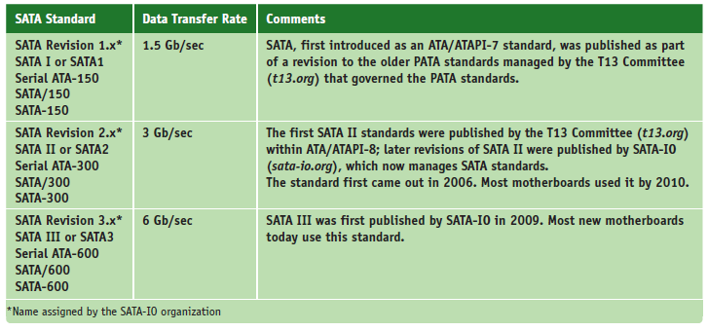
Interface Standards Used by a Hard Drive (SATA)
Table 6-1 SATA standards
Notes:
SATA Interface Standards Used by a Hard Drive

Slide 13
SATA Interface Standards Used by a Hard Drive
Serial ATA standards are used by all drive types
Supports hot-swapping (hot-plugging)
Connect and disconnect drive while system is running
Connects to one internal SATA connector on the motherboard via a 7-pin SATA data cable
Uses a 15-pin SATA power connector
A motherboard might have two or more SATA connectors
Use connectors in the order recommended in the motherboard user guide
Notes:
SATA Interface Standards Used by a Hard Drive
Serial ATA standards are used by all drive types
Supports hot-swapping (hot-plugging)
Connect and disconnect drive while system is running
Connects to one internal SATA connector on the motherboard via a 7-pin SATA data cable
Uses a 15-pin SATA power connector
A motherboard might have two or more SATA connectors
Use connectors in the order recommended in the motherboard user guide

Slide 14
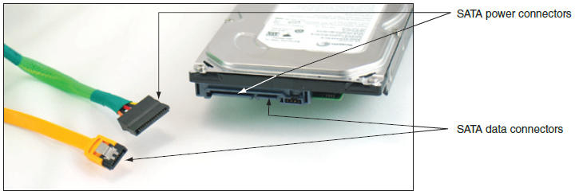
SATA Interface Standards Used by a Hard Drive
Figure 6-6 A SATA data cable and SATA power cable
Notes:
SATA Interface Standards Used by a Hard Drive

Slide 15
SATA Interface Standards Used by a Hard Drive
Motherboard or expansion card can provide external SATA (eSATA) ports for external drives
External SATA (eSATA)
eSATA drives use special external shielded serial ATA cable up to 2 meters long
Purchasing considerations
SATA standards for the drive and motherboard need to match for optimum speed
If no match, system runs at the slower speed
Notes:
SATA Interface Standards Used by a Hard Drive
Motherboard or expansion card can provide external SATA (eSATA) ports for external drives
External SATA (eSATA)
eSATA drives use special external shielded serial ATA cable up to 2 meters long
Purchasing considerations
SATA standards for the drive and motherboard need to match for optimum speed
If no match, system runs at the slower speed

Slide 16
How to Select and Install Hard Drives
Topics covered
Selecting a hard drive
Installation details for a SATA drive
How to install hard drive in a bay too wide for drive
How to set up a RAID system
Notes:
How to Select and Install Hard Drives
Topics covered
Selecting a hard drive
Installation details for a SATA drive
How to install hard drive in a bay too wide for drive
How to set up a RAID system

Slide 17
Selecting a Hard Drive
Hard drive must match OS and motherboard
Need to know what standards the motherboard or controller card providing the drive interface can use
Consult documentation for the board or card
UEFI/BIOS uses autodetection to prepare the device
Drive capacity and configuration selected
Best possible standard becomes part of configuration
Notes:
Selecting a Hard Drive
Hard drive must match OS and motherboard
Need to know what standards the motherboard or controller card providing the drive interface can use
Consult documentation for the board or card
UEFI/BIOS uses autodetection to prepare the device
Drive capacity and configuration selected
Best possible standard becomes part of configuration

Slide 18
Selecting a Hard Drive
Considerations:
Drive capacity
Today’s desktop hard drives range from 1 TB for SSD to more than 6 TB for magnetic
Spindle speed
Most common is 7200 RPM
The higher the RPMs, the faster the drive
Interface standard
Use standards the motherboard supports
Cache or buffer size
Ranges from 2 MB to 128 MB
Notes:
Selecting a Hard Drive
Considerations:
Drive capacity
Today’s desktop hard drives range from 1 TB for SSD to more than 6 TB for magnetic
Spindle speed
Most common is 7200 RPM
The higher the RPMs, the faster the drive
Interface standard
Use standards the motherboard supports
Cache or buffer size
Ranges from 2 MB to 128 MB

Slide 19
Steps to Install a SATA Drive
A SATA drive might have jumpers
Most likely set by factory as they should be
Some SATA drives have two power connectors
Choose only one to use
Never install two power cords at the same time
May have to purchase controller card when the motherboard drives connectors are not functioning
Or if the motherboard does not support a fast SATA standard that your hard drives uses
Notes:
Steps to Install a SATA Drive
A SATA drive might have jumpers
Most likely set by factory as they should be
Some SATA drives have two power connectors
Choose only one to use
Never install two power cords at the same time
May have to purchase controller card when the motherboard drives connectors are not functioning
Or the if the motherboard does not support a fast SATA standard that your hard drives uses

Slide 20
Steps to Install a SATA Drive
Step 1: Know your starting point
How is your system configured?
Is everything working properly?
Write down what you know about the system
Step 2: Read the documentation and prepare your work area
Read all installation instructions first
Visualize all the steps
Protect against ESD and avoid working on carpet
Notes:
Steps to Install a SATA Drive
Step 1: Know your starting point
How is your system configured?
Is everything working properly?
Write down what you know about the system
Step 2: Read the documentation and prepare your work area
Read all installation instructions first
Visualize all the steps
Protect against ESD and avoid working on carpet

Slide 21
Steps to Install a SATA Drive
Step 2: Read the documentation and prepare your work area (cont’d)
Handle the drive carefully
Do not touch any exposed circuitry
Prevent other people from touching exposed microchips
Drain static electricity from the package and from your body by touching metal for at least 2 seconds
If you must set it down, place it component-side up
Do not place the drive on the computer case or on a metal table
Notes:
Steps to Install a SATA Drive
Step 2: Read the documentation and prepare your work area (cont’d)
Handle the drive carefully
Do not touch any exposed circuitry
Prevent other people from touching exposed microchips
Drain static electricity from the package and from your body by touching metal for at least 2 seconds
If you must set it down, place it component-side up
Do not place the drive on the computer case or on a metal table

Slide 22
Steps to Install a SATA Drive
Step 3: Install the drive
Shut down the computer and unplug it
Decide which bay will hold the drive
Slide drive in the bay and secure it (use two screws on both sides)
Use correct motherboard SATA connector
Connect a 15-pin SATA or 4-pin Molex power connector from the power supply to the drive
Check all connections and power up the system
Verify drive recognized correctly via UEFI/BIOS setup
Notes:
Steps to Install a SATA Drive
Step 3: Install the drive
Shut down the computer and unplug it
Decide which bay will hold the drive
Slide drive in the bay and secure it (use two screws on both sides)
Use correct motherboard SATA connector
Connect a 15-pin SATA or 4-pin Molex power connector from the power supply to the drive
Check all connections and power up the system
Verify drive recognized correctly via UEFI/BIOS setup

Slide 23
Steps to Install a SATA Drive
You are ready to prepare the hard drive for first use
Boot from Windows setup DVD
Follow directions on the screen to install Windows on the new drive
If installing a second hard drive with Windows installed on first drive use Windows Disk Management utility to partition and format the second drive
Notes:
Steps to Install a SATA Drive
You are ready to prepare the hard drive for first use
Boot from Windows setup DVD
Follow directions on the screen to install Windows on the new drive
If installing a second hard drive with Windows installed on first drive use Windows Disk Management utility to partition and format the second drive

Slide 24
Installing a Drive in a Removable Bay
Unplug the cage fan from its power source
Turn handle on each locking device counterclockwise to remove it
Slide the bay to the front and out of the case
Insert hard drive in the bay
Use two screws on each side to anchor the drive in the bay
Slide the bay back into the case
Reinstall the locking pins
Plug in the cage fan power cord
Notes:
Installing a Drive in a Removable Bay
Unplug the cage fan from its power source
Turn handle on each locking device counterclockwise to remove it
Slide the bay to the front and out of the case
Insert hard drive in the bay
Use two screws on each side to anchor the drive in the bay
Slide the bay back into the case
Reinstall the locking pins
Plug in the cage fan power cord

Slide 25
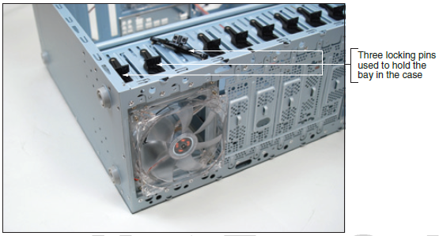
Installing a Drive in a Removable Bay
Figure 6-19 The removable bay has a fan in front and is anchored to the case with locking pins
Notes:
Installing a Drive in a Removable Bay

Slide 26
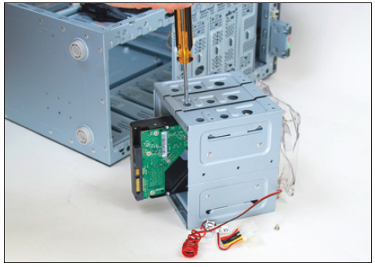
Installing a Drive in a Removable Bay
Figure 6-20 Install the hard drive in the bay using two screws on each side of the drive
Notes:
Installing a Drive in a Removable Bay

Slide 27
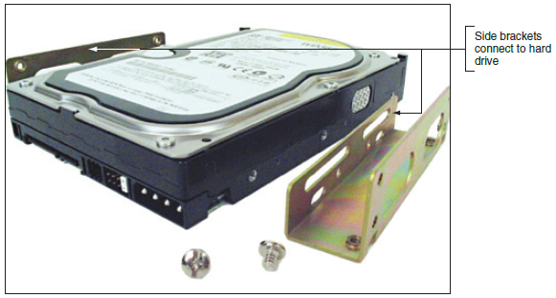
Installing a Small Drive in a Wide Bay
Use a universal bay kit to securely fit a small drive into the bay
The adapter spans the distance between the sides of the drive and bay
Figure 6-21 Use the universal bay kit to make the drive fit the bay
Notes:
Installing a Small Drive in a Wide Bay
Use a universal bay kit to securely fit a small drive into the bay
The adapter spans the distance between the sides of the drive and bay

Slide 28
Installing a Hard Drive in a Laptop
General guidelines:
See manufacturer’s documentation for drive sizes and connector types
Be aware of voiding manufacturer’s warranty
Considerations when shopping for a laptop drive:
Laptop drive is 2.5 or 1.8 inches wide
May use SSD (solid state device) technology
Hard drives connector: SATA or PATA (older laptops)
If upgrading, may want to use a USB-to-SATA converter, so both drives can be working and you can copy files from one to the other
Notes:
Installing a Hard Drive in a Laptop
General guidelines:
See manufacturer’s documentation for drive sizes and connector types
Be aware of voiding manufacturer’s warranty
Considerations when shopping for a laptop drive:
Laptop drive is 2.5 or 1.8 inches wide
May use SSD (solid state device) technology
Hard drives connector: SATA or PATA (older laptops)
If upgrading, may want to use a USB-to-SATA converter, so both drives can be working and you can copy files from one to the other

Slide 29
Installing a Hard Drive in a Laptop
Older laptop computers required disassembly
Newer notebooks: easy to replace
If UEFI/BIOS setup uses autodetect:
System boots up and UEFI/BIOS recognizes new drive
Searches for an operating system
If a new drive: boot from Windows recovery CD and install the OS
Notes:
Installing a Hard Drive in a Laptop
Older laptop computers required disassembly
Newer notebooks: easy to replace
If UEFI/BIOS setup uses autodetect:
System boots up and UEFI/BIOS recognizes new drive
Searches for an operating system
If a new drive: boot from Windows recovery CD and install the OS

Slide 30
Setting Up Hardware RAID
RAID (Redundant Array of Inexpensive Disks)
Also called: Redundant Array of Independent Disks
A technology that configures two or more hard drives to work together as an array of drives
Why use RAID?
To improve fault tolerance by writing two copies of it, each to a different hard drive
To improve performance by writing data to two or more hard drives so that a single drive is not excessively used
Notes:
Setting Up Hardware RAID
RAID (Redundant Array of Inexpensive Disks)
Also called: Redundant Array of Independent Disks
A technology that configures two or more hard drives to work together as an array of drives
Why use RAID?
To improve fault tolerance by writing two copies of it, each to a different hard drive
To improve performance by writing data to two or more hard drives to that a single drive is not excessively used

Slide 31
Types of RAID
Spanning – sometimes called JBOD (just a bunch of disks)
Uses two hard drives to hold a single Windows volume
When one drive is full, data is written to second drive
RAID 0 – uses two or more physical disks
Writes to physical disks evenly across all disks so that no one disk receives all activity
Windows calls RAID 0 a striped volume
Notes:
Types of RAID
Spanning – sometimes called JBOD (just a bunch of disks)
Uses two hard drives to hold a single Windows volume
When one drive is full, data is written to second drive
RAID 0 – uses two or more physical disks
Writes to physical disks evenly across all disks so that no one disk receives all activity
Windows calls RAID 0 a striped volume

Slide 32
Types of RAID
RAID 1: Mirroring
Duplicates data on one drive to another drive and is used for fault tolerance (mirrored volume)
RAID 5: uses three or more drives
Stripes data across drives and uses parity checking
Data is not duplicated
RAID 10: RAID 1+0 (pronounced RAID one zero)
Combination of RAID 1 and RAID 0
Takes at least 4 disks
Data is mirrored across pairs of disks
Notes:
Types of RAID
RAID 1: Mirroring
Duplicates data on one drive to another drive and is used for fault tolerance (mirrored volume)
RAID 5: uses three or more drives
Stripes data across drives and uses parity checking
Data is not duplicated
RAID 10: RAID 1+0 (pronounced RAID one zero)
Combination of RAID 1 and RAID 0
Takes at least 4 disks
Data is mirrored across pairs of disks

Slide 33
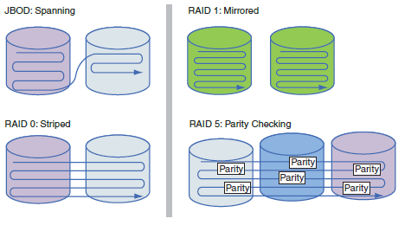
Types of RAID
Figure 6-26 Ways that hard drives can work together
Notes:
Types of RAID
RAID 1: Mirroring
Duplicates data on one drive to another drive and is used for fault tolerance (mirrored volume)
RAID 5: uses three or more drives
Stripes data across drives and uses parity checking
Data is not duplicated
RAID 10: RAID 1+0 (pronounced RAID one zero)
Combination of RAID 1 and RAID 0
Takes at least 4 disks
Data is mirrored across pairs of disks

Slide 34
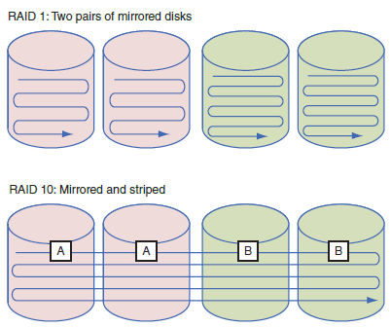
Types of RAID
Figure 6-27 RAID 1 and RAID 10
Notes:
Types of RAID
RAID 1: Mirroring
Duplicates data on one drive to another drive and is used for fault tolerance (mirrored volume)
RAID 5: uses three or more drives
Stripes data across drives and uses parity checking
Data is not duplicated
RAID 10: RAID 1+0 (pronounced RAID one zero)
Combination of RAID 1 and RAID 0
Takes at least 4 disks
Data is mirrored across pairs of disks

Slide 35
How to Implement Hardware RAID
Hardware implementation
Hardware RAID controller or RAID controller card
Motherboard does the work
Software implementation
Best RAID performance
All hard drives in an array should be identical in brand, size, speed, other features
If Windows is to be installed on a RAID hard drive
RAID must be implemented before Windows installed
Notes:
How to Implement Hardware RAID
Hardware implementation
Hardware RAID controller or RAID controller card
Motherboard does the work
Software implementation uses operating system
Best RAID performance
All hard drives in an array should be identical in brand, size, speed, other features
If Windows is to be installed on a RAID hard drive
RAID must be implemented before Windows installed

Slide 36
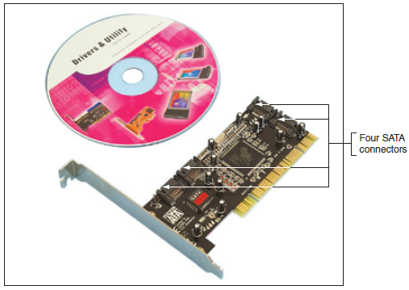
How to Implement Hardware RAID
Figure 6-28 RAID controller card provides four SATA internal connectors
Notes:
How to Implement Hardware RAID

Slide 37
How to Implement Hardware Raid
General directions to install RAID 5 array using three matching SATA drives
Install drives in the computer case and connect each to motherboard
Boot system and enter UEFI/BIOS setup
Verify drives recognized, select option to configure SATA, and select RAID
Notes:
How to Implement Hardware Raid
General directions to install RAID 5 array using three matching SATA drives
Install drives in the computer case and connect each to motherboard
Boot system and enter UEFI/BIOS setup
Verify drives recognized, select option to configure SATA, and select RAID
Reboot the system
Press Ctrl and I to enter the RAID configuration utility
Select option 1 to “Create RAID Volume”
Select RAID 5 (Parity), stripe size value, volume size
Create volume

Slide 38
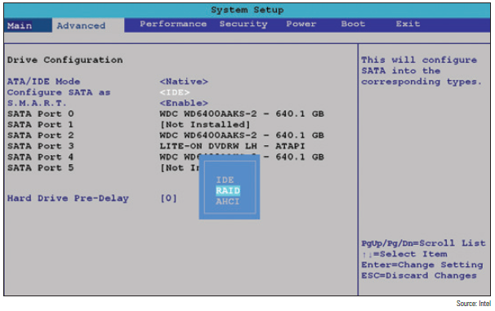
How to Implement Hardware Raid
Figure 6-30 Configure SATA ports on the motherboard to enable RAID
Notes:
How to Implement Hardware Raid

Slide 39
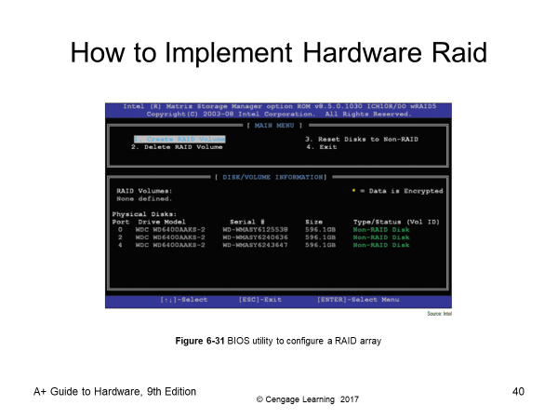
How to Implement Hardware Raid
Reboot the system
Press Ctrl and I to enter the RAID configuration utility
Select option 1 to “Create RAID Volume”
Notes:
How to Implement Hardware Raid
General directions to install RAID 5 array using three matching SATA drives
Install drives in the computer case and connect each to motherboard
Boot system and enter UEFI/BIOS setup
Verify drives recognized, select option to configure SATA, and select RAID
Reboot the system
Press Ctrl and I to enter the RAID configuration utility
Select option 1 to “Create RAID Volume”
Select RAID 5 (Parity), stripe size value, volume size
Create volume

Slide 40
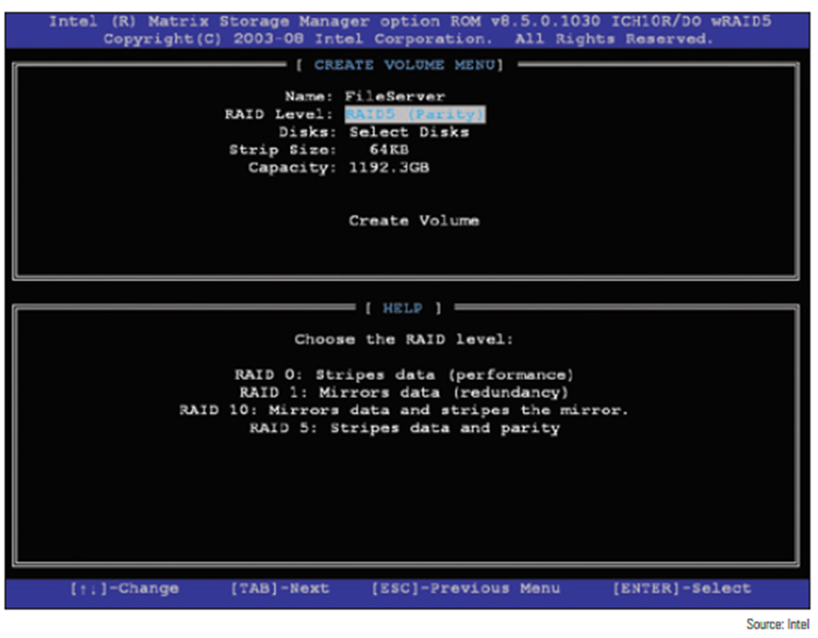
How to Implement Hardware Raid
Select RAID 5 (Parity), stripe size value, volume size
Create volume
Notes:
How to Implement Hardware Raid
General directions to install RAID 5 array using three matching SATA drives
Install drives in the computer case and connect each to motherboard
Boot system and enter UEFI/BIOS setup
Verify drives recognized, select option to configure SATA, and select RAID
Reboot the system
Press Ctrl and I to enter the RAID configuration utility
Select option 1 to “Create RAID Volume”
Select RAID 5 (Parity), stripe size value, volume size
Create volume

Slide 41
External Enclosures
Hard drives are sometimes stored in external enclosures
Make it easy to expand storage capacity of a single computer or make available hard drive storage to an entire network
For network attached storage (NAS)
Enclosure connects to the network via Ethernet port
Hard drives inside the enclosure might use a SATA connection
Notes:
External Enclosures
Hard drives are sometimes stored in external enclosures
Make it easy to expand storage capacity of a single computer or make available hard drive storage to an entire network
For network attached storage (NAS)
Enclosure connects to the network via Ethernet port
Hard drives inside the enclosure might use a SATA connection

Slide 42
External Enclosures
What to know about supporting external enclosures:
Enclosure might contain firmware that supports RAID
To replace a hard drive in an enclosure, see the documentation for the enclosure
If a computer case is overheating, remove hard drives from the case and install them in an external enclosure
It is better to leave the hard drive that contains the Windows installation in the case
Notes:
External Enclosures
What to know about supporting external enclosures:
Enclosure might contain firmware that supports RAID
To replace a hard drive in an enclosure, see the documentation for the enclosure
If a computer case is overheating, remove hard drives from the case and install them in an external enclosure
It is better to leave the hard drive that contains the Windows installation in the case

Slide 43
About Tape Drives
Tapes drives – an inexpensive way of backing up a hard drive
WORM (write once read many) – assures data written will not be deleted or overwritten
Disadvantage: data is stored by sequential access
To read data from anywhere on the tape, you must start at the beginning of the tape and read until you find the data you want
Slow and inconvenient
Notes:
About Tape Drives
Tapes drives – an inexpensive way of backing up a hard drive
WORM (write once read many) – assures data written will not be deleted or overwritten
Disadvantage: data is stored by sequential access
To read data from anywhere on the tape, you must start at the beginning of the tape and read until you find the data you want
Slow and inconvenient

Slide 44
About Tape Drives
Two kinds of tapes:
Full-sized data cartridges
Minicartridges - popular because their drives can fit into a standard 3-inch drive bay of a PC case
Common types of tape cartridges:
DDS (Digital Data Storage)
LTO (Linear Tape-Open)
DLT (Digital Linear Tape)
SDLT (Super Digital Linear Tape)
Travan
Notes:
About Tape Drives
Two kinds of tapes:
Full-sized data cartridges
Minicartridges - popular because their drives can fit into a standard 3-inch drive bay of a PC case
Common types of tape cartridges:
DDS (Digital Data Storage)
LTO (Linear Tape-Open)
DLT (Digital Linear Tape)
SDLT (Super Digital Linear Tape)
Travan

Slide 45
About Tape Drives
Common types of tape cartridges (cont’d):
AIT (Advanced Intelligent Tape)
SLR (Scalable Linear Recording)
When selecting a tape drive, consider:
How many and what type of cartridges the drive can use
How it interfaces with the computer
External drives can connect to a computer using a USB, FireWire, SCSI, SAS, or eSATA port
Notes:
About Tape Drives
Common types of tape cartridges (cont’d):
AIT (Advanced Intelligent Tape)
SLR (Scalable Linear Recording)
When selecting a tape drive, consider:
How many and what type of cartridges the drive can use
How it interfaces with the computer
External drives can connect to a computer using a USB, FireWire, SCSI, SAS, or eSATA port

Slide 46
Supporting Other Types of Storage Drives
Storage devices to support might include:
Optical discs
USB flash drives
Memory cards
Notes:
Supporting Other Types of Storage Drives
Storage devices to support might include:
Optical discs
USB flash drives
Memory cards

Slide 47
File Systems Used by Storage Devices
File system – used to manage data stored on a device
Overall structure the OS uses to name, store, and organize files on a drive
In Windows, each storage device is assigned a driver letter
Formatting – installing a new file system on a device
Types of file systems:
NTFS, exFAT, FAT32 and FAT
Notes:
File Systems Used by Storage Devices
File system – used to manage data stored on a device
Overall structure the OS uses to name, store, and organize files on a drive
In Windows, each storage device is assigned a driver letter
Formatting – installing a new file system on a device
Types of file systems:
NTFS, exFAT, FAT32 and FAT

Slide 48
Standards Used by Optical Drives and Discs
CDs, DVDs, and Blu-ray discs (BD) use similar laser technologies
Tiny lands and pits on surface represent bits read by a laser beam
CD drives use CDFS (Compact Disc File System) or UDF (Universal Disk Format) file system
DVD and Blue-ray drives use UDF
Internal optical drive interfaces with motherboard via a SATA connection
External might use eSATA, FireWire, or USB
Notes:
Standards Used by Optical Drives and Discs
CDs, DVDs, and Blu-ray discs (BD) use similar laser technologies
Tiny lands and pits on surface represent bits read by a laser beam
CD drives use CDFS (Compact Disc File System) or UDF (Universal Disk Format) file system
DVD and Blue-ray drives use UDF
Internal optical drive interfaces with motherboard via a SATA connection
External might use eSATA, FireWire, or USB

Slide 49
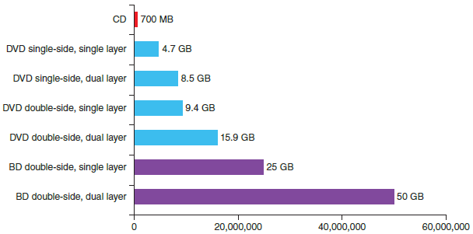
Standards Used by Optical Drives
Data can be written to:
One side of a CD
One or both sides of a DVD or Blu-ray disc
DVD or Blu-ray disc can hold in two layers on each side
Figure 6-42 Storage
capacities for CDs, DVDs,
and BD discs
Notes:
Standards Used by Optical Drives
Data can be written to:
One side of a CD
One or both sides of a DVD or Blu-ray disc
DVD or Blu-ray disc can hold in two layers on each side

Slide 50
Replacing an Optical Drive on a Laptop
Replacing optical drives:
Unplug the AC adapter and remove the battery pack
Remove keyboard (not all laptops require this step)
Remove screw holding DVD drive to the laptop
Slide drive out of the bay and new drive into the bay
Ensure connection with drive connector
Replace the screw
Notes:
Replacing an Optical Drive on a Laptop
Replacing optical drives:
Unplug the AC adapter and remove the battery pack
Remove keyboard (not all laptops require this step)
Remove screw holding DVD drive to the laptop
Slide drive out of the bay and new drive into the bay
Ensure connection with drive connector
Replace the screw

Slide 51
Solid State Storage
Solid-state storage:
SSD hard drives, USB flash drives, and memory cards
USB flash drives go by many names:
Flash pen drive, jump drive, thumb drive, and key drive
Might work at USB 2.0 or USB 3.0 speed
Use FAT or exFAT file system
Windows 10 has embedded drivers to support flash drives
Notes:
Solid State Storage
Solid-state storage:
SSD hard drives, USB flash drives, and memory cards
USB flash drives go by many names:
Flash pen drive, jump drive, thumb drive, and key drive
Might work at USB 2.0 or USB 3.0 speed
Use FAT or exFAT file system
Windows 8/7/Vista has embedded drivers to support flash drives

Slide 52
Solid State Storage
Memory cards might be used in:
Digital cameras, tablets, cell phones, MP3 players, digital camcorders, etc…
Most laptops have memory card slots
Notes:
Solid State Storage
Memory cards might be used in:
Digital cameras, tablets, cell phones, MP3 players, digital camcorders, etc…
Most laptops have memory card slots
SD (Secure Digital) Association is responsible for standards:
1.x (regular SD)
2.x (SD High Capacity or SDHC)
3.x (SD eXtended Capacity or SDXC)
SD cards come in three physical sizes

Slide 53
Troubleshooting Hard Drives
Problems caused by hard drive during the boot can be caused by:
Hard drive subsystem
File system on the drive
Files required by Windows when it begins to load
When trying to solve a problem with the boot
Decide if the problem is caused by hardware or software
Notes:
Troubleshooting Hard Drives
Problems caused by hard drive during the boot can be caused by:
Hard drive subsystem
File system on the drive
Files required by Windows when it begins to load
When trying to solve a problem with the boot
Decide if the problem is caused by hardware or software

Slide 54
Slow Performance
Common complaint:
Computer is running slowly
Try running the defragmentation tool on the hard drive
The Windows defragmentation tool rearranges fragments or part of files in contiguous clusters so files are easier and faster to find
Notes:
Slow Performance
Common complaint:
Computer is running slowly
Try running the defragmentation tool on the hard drive
The Windows defragmentation tool rearranges fragments or part of files in contiguous clusters so files are easier and faster to find

Slide 55
Hard Drive Problems During the Boot
Hardware problems usually show up at POST
Could be due to the drive, data cable, electrical system, motherboard, or a loose connection
Things to do and check before opening case:
Check to see if UEFI/BIOS displays a numeric error code or other message during POST
Check UEFI/BIOS setup for errors in the hard drive configuration
Try booting from another bootable media
For a RAID array, use the firmware utility to check the status of each disk in the array and check for errors
Notes:
Hard Drive Problems During the Boot
Hardware problems usually show up at POST
Could be due to the drive, data cable, electrical system, motherboard, or a loose connection
Things to do and check before opening case:
Check to see if UEFI/BIOS displays a numeric error code or other message during POST
Check UEFI/BIOS setup for errors in the hard drive configuration
Try booting from another bootable media
For a RAID array, use the firmware utility to check the status of each disk in the array and check for errors

Slide 56
Hard Drive Problems During the Boot
If the problem is still not solved, open case and check these things:
Remove and reattach all drive cables
If using a RAID, SATA, PATA, or SCSI controller card, remove and reseat it or place in a different slot
Inspect drive for damage
Determine if hard drive is spinning by listening to it
Check the cable for frayed edges
Check installation manual
S.M.A.R.T. errors mean data should be backed up and drive replaced as soon as possible
Notes:
Hard Drive Problems During the Boot
If the problem is still not solved, open case and check these things:
Remove and reattach all drive cables
If using a RAID, SATA, PATA, or SCSI controller card, remove and reseat it or place in a different slot
Inspect drive for damage
Determine if hard drive is spinning by listening to it
Check the cable for frayed edges
Check installation manual
S.M.A.R.T. errors mean data should be backed up and drive replaced as soon as possible

Slide 57
Hard Drive Problems During the Boot
If the problem is still not solved, open case and check these things (cont’d):
Use Windows tools for checking a hard drive
Check the drive manufacturer’s web site for diagnostic software
Move the device to a working computer and install it as a second drive
Exchange the three field replaceable units
Reconnect or swap the data cable
Reseat or exchange the controller card
Exchange the hard drive for a known good drive
Notes:
Hard Drive Problems During the Boot
If the problem is still not solved, open case and check these things (cont’d):
Use Windows tools for checking a hard drive
Check the drive manufacturer’s web site for diagnostic software
Move the device to a working computer and install it as a second drive
Exchange the three field replaceable units
Reconnect or swap the data cable
Reseat or exchange the controller card
Exchange the hard drive for a known good drive

Slide 58
Hard Drive Problems During the Boot
If the problem is still not solved, open case and check these things (cont’d):
Use Windows tools for checking a hard drive
Check the drive manufacturer’s web site for diagnostic software
Move the device to a working computer and install it as a second drive
Try these things to clean the drive and get a fresh start:
Format the drive
Use diskpart to start over with a fresh file system
Notes:
Hard Drive Problems During the Boot
If the problem is still not solved, open case and check these things (cont’d):
Use Windows tools for checking a hard drive
Check the drive manufacturer’s web site for diagnostic software
Move the device to a working computer and install it as a second drive
Try these things to clean the drive and get a fresh start:
Format the drive
Use diskpart to start over with a fresh file system

Slide 59
Hard Drive Problems During the Boot
If the problem is still not solved, open case and check these things (cont’d):
Exchange the three field replaceable units
Reconnect or swap the data cable
Reseat or exchange the controller card
Exchange the hard drive for a known good drive
If your drives whines loudly, try replacing it
A bad power supply or a bad motherboard also might cause a disk boot failure
Notes:
Hard Drive Problems During the Boot
If the problem is still not solved, open case and check these things (cont’d):
Exchange the three field replaceable units
Reconnect or swap the data cable
Reseat or exchange the controller card
Exchange the hard drive for a known good drive
If your drives whines loudly, try replacing it
A bad power supply or a bad motherboard also might cause a disk boot failure

Slide 60
Summary
A hard disk drive (HDD) comes in 3.5” for desktop and 2.5” and 1.8” for laptops
A hard drive can be magnetic, solid-state, or hybrid
Most hard drives, tape drives, and optical drives use the SATA interface standards
Three SATA standards provide data rates of 1.5 Gb/sec, 3.0 Gb/sec, and 16.0 Gb/sec
S.M.A.R.T is a self-monitoring technology whereby the BIOS monitors the health of a hard drive
Notes:
Summary
A hard disk drive (HDD) comes in 3.5” for desktop and 2.5” and 1.8” for laptops
A hard drive can be magnetic, solid-state, or hybrid
Most hard drives, tape drives, and optical drives use the SATA interface standards
Three SATA standards provide data rates of 1.5 Gb/sec, 3.0 Gb/sec, and 16.0 Gb/sec
S.M.A.R.T is a self-monitoring technology whereby the BIOS monitors the health of a hard drive

Slide 61
Summary
When selecting a hard drive, consider storage capacity, technology, spindle speed, interface standard, and buffer size
SATA drives require no configuration and are installed using a power cord and a data cable
Laptop hard drives plug directly into a SATA connection on the system board
RAID technology uses an array of hard drives to provide fault tolerance and/or improvement in performance
Notes:
Summary
When selecting a hard drive, consider storage capacity, technology, spindle speed, interface standard, and buffer size
SATA drives require no configuration and are installed using a power cord and a data cable
Laptop hard drives plug directly into a SATA connection on the system board
RAID technology uses an array of hard drives to provide fault tolerance and/or improvement in performance

Slide 62
Summary
Hardware RAID is implemented using the motherboard UEFI/BIOS or a RAID controller card
Software RAID is implemented in Windows
Tape drives are an inexpensive way to back up an entire hard drive or portions of it
File systems a storage device might use in Windows include NTFS, exFAT, and FAT
Optical discs can be recordable (CD-R) or rewritable (DVD-RW)
Notes:
Summary
Hardware RAID is implemented using the motherboard UEFI/BIOS or a RAID controller card
Software RAID is implemented in Windows
Tape drives are an inexpensive way to back up an entire hard drive or portions of it
File systems a storage device might use in Windows include NTFS, exFAT, and FAT
Optical discs can be recordable (CD-R) or rewritable (DVD-RW)

Slide 63
Summary
Types of flash memory standards include SD, MiniSD, MicroSD, SDHC, MiniSDHC, MicroSDHC, SDXC, MicroSDXC
Other memory cards include Memory Stick PRO Duo, Memory Stick PRO, Memory Stick Micro M2, CompactFlash I and II, and xD-Picture Card
Problems caused by the hard drive during a boot can be caused by the hard drive subsystem, file system, or by files required by Windows to load
Notes:
Summary
Types of flash memory standards include SD, MiniSD, MicroSD, SDHC, MiniSDHC, MicroSDHC, SDXC, MicroSDXC
Other memory cards include Memory Stick PRO Duo, Memory Stick PRO, Memory Stick Micro M2, CompactFlash I and II, and xD-Picture Card
Problems caused by the hard drive during a boot can be caused by the hard drive subsystem, file system, or by files required by Windows to load

